Slide 1
Furniture and appliances
Basic 04

Slide 2
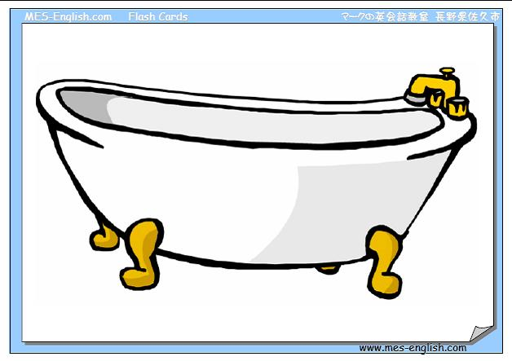
Bathtub

Slide 3
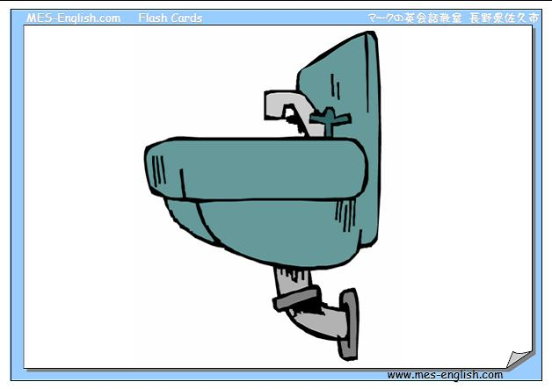
Sink

Slide 4

Shower

Slide 5

Toilet

Slide 6

Toilet paper

Slide 7

Bed

Slide 8
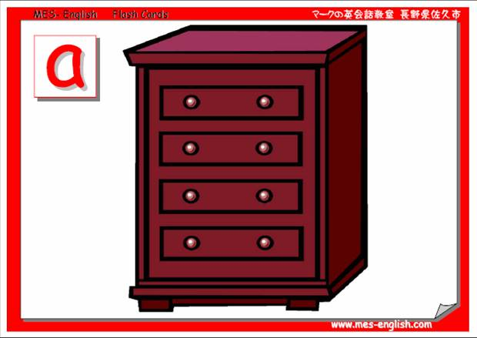
Dresser

Slide 9
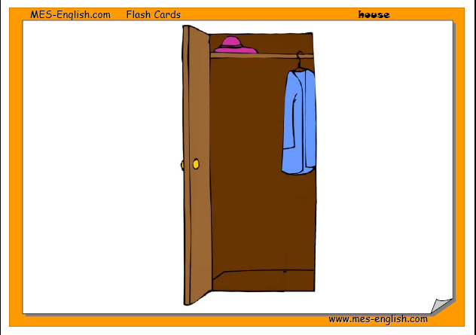
Closet

Slide 10
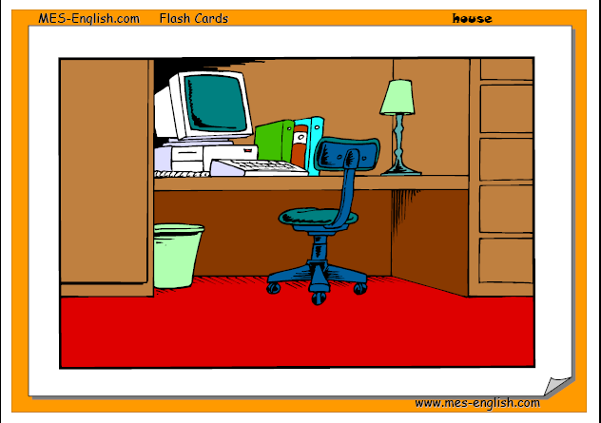
Desk and Chair

Slide 11
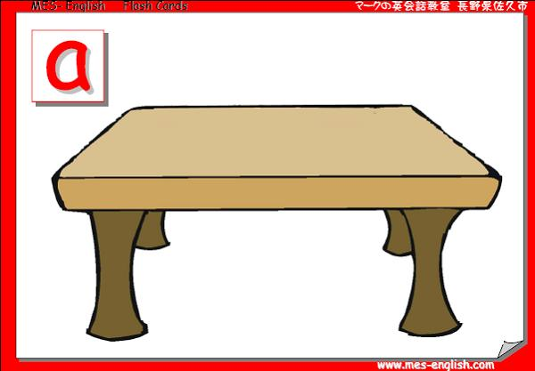
Table

Slide 12
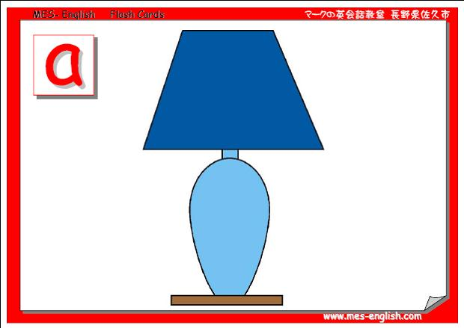
Lamp

Slide 13

Rug

Slide 14

Mirror

Slide 15
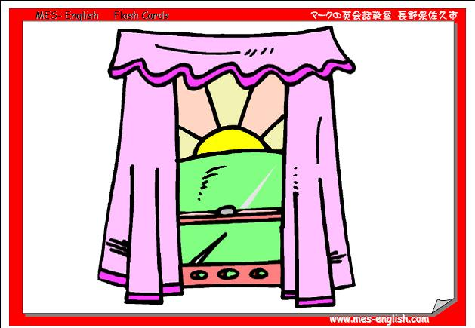
Curtains

Slide 16
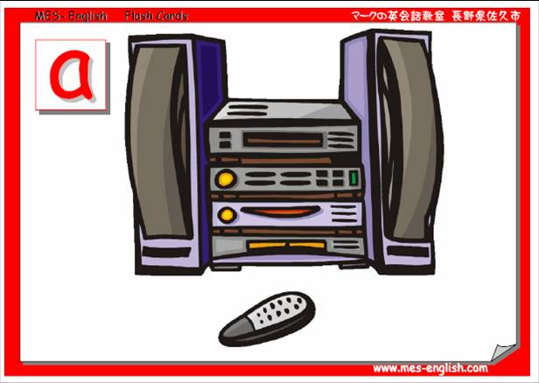
Stereo

Slide 17
Faucet

Slide 18
Stove

Slide 19
Refrigerator - fridge

Slide 20
Microwave

Slide 21
Coffee maker

Slide 22
Blender

